Slide 1


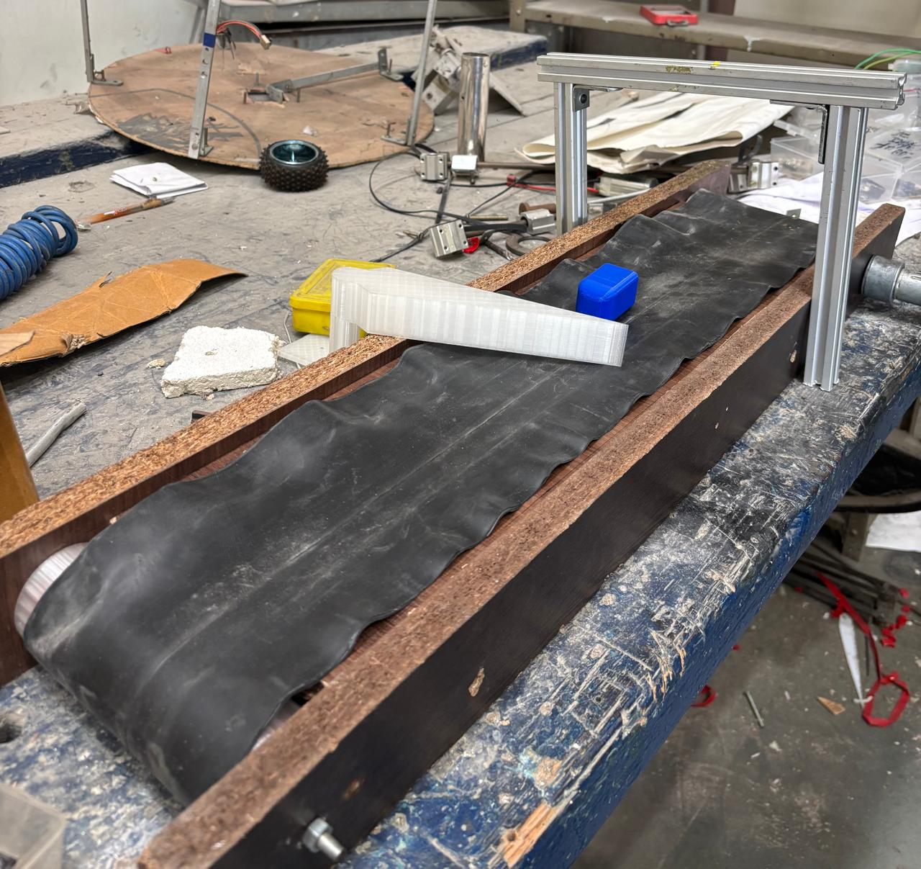
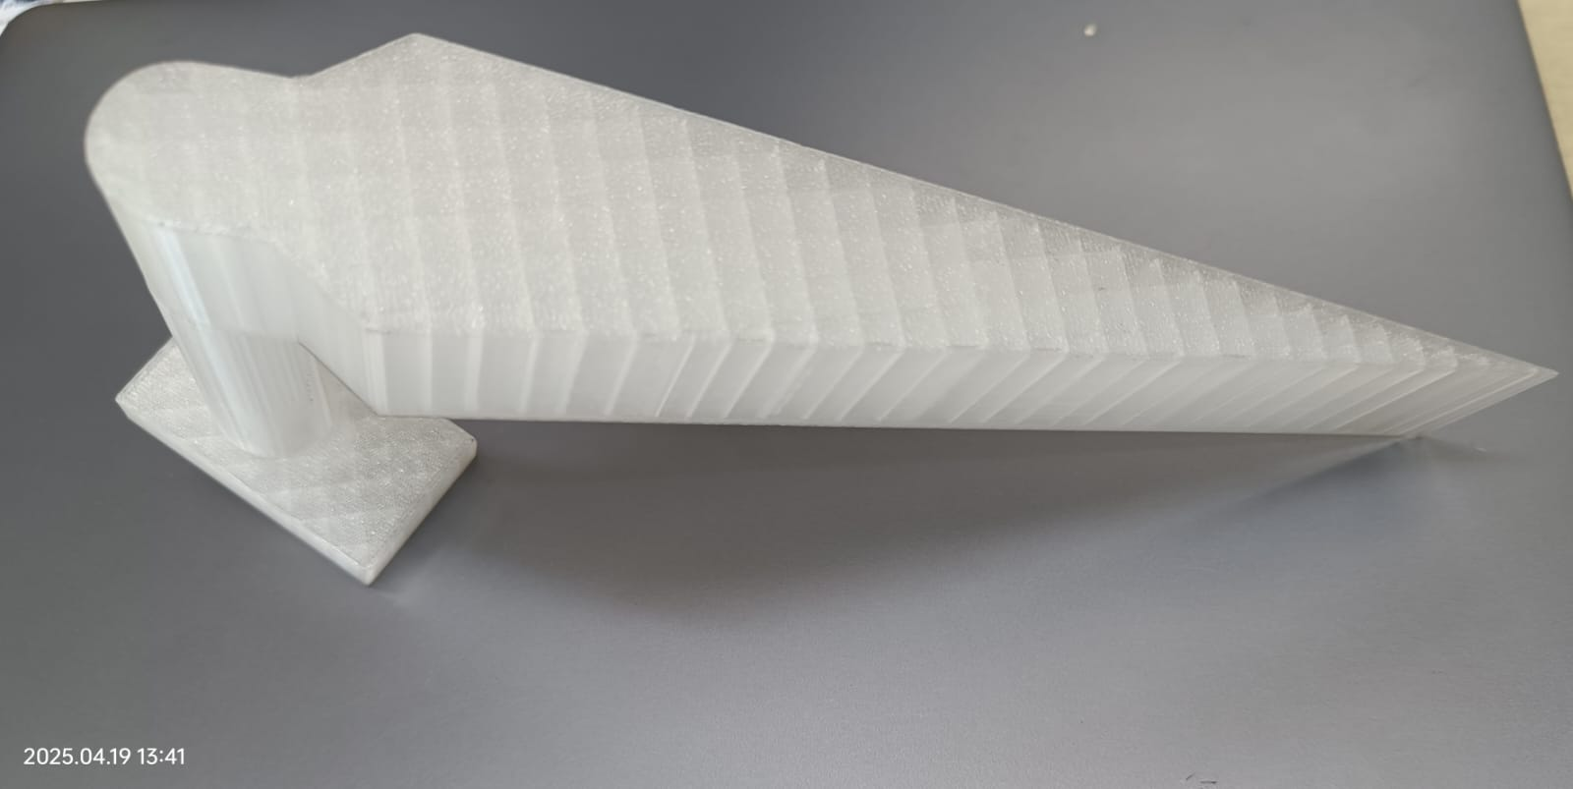
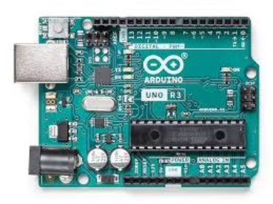
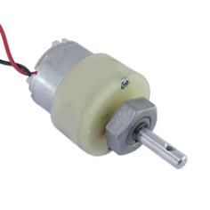
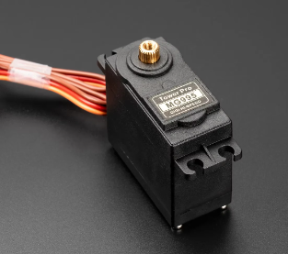
OBJECT CLASSIFIER USING
CONVEYOR BELT
IDEATION Manual sorting is time-consuming and inefficient. This project automates object classification using computer vision and a conveyor belt. Objects are sorted into red, blue, or trash categories based on HSV color detection. The system is scalable and ideal for educational and demo use.
PROTOTYPE DESCRIPTION
MECHANICAL ASPECT: The system includes a motor-driven conveyor belt and a classifying arm (servo motor). A webcam captures live frames, and classification is done via OpenCV. Arduino Uno controls the motor and arm. A single actuator is used to achieve trinary classification. An ultrasonic sensor is used to detect whether an object is coming on the conveyer belt or not.
TECHNICAL ASPECT:
Camera + OpenCV: Uses HSV color space for more reliable object detection under varying lighting.
Classification: Objects are sorted into Red, Blue, and Trash using real-time color analysis.
Arduino Uno: Receives commands via serial and controls the gear motor (conveyor) and servo (classifier arm).
Frame Processing: Analyzes each frame live to ensure accurate detection and actuation.
Optimized Setup: Black background enhances contrast for better contour detection.
RESULT & CONCLUSION System accurately classifies objects based on color and routes them with a servo-controlled arm. It is low-cost, reliable, and educational. Future Enhancements: - AI/ML-based recognition - Multi-color support - Automated sorting arms - Cloud-based monitoring

